Slide 1

(Information and Communication Technologies)
Final project about TIC tools and technologies
University of Science and Technology Houari Boumediene
Faculty of Computer Science
Prepared by: Mehis Alae Khadidja
Groupe ID: ID7
Academic Year: 2025-2026

Slide 2


Introduction
1
Introduction
2
Overview of TIC
3
Google Services
4
Microsoft Tools
5
Web Technologies (HTML & CSS)
6
LaTeX
7
Version Control: Git & GitHub
8
Conclusion

Slide 3
Introduction
Information and Communication Technologies (TIC) all the tools and systems we use every day to connect, share, and manage information easily. From computers and smartphones to software and online applications, TIC makes it possible for people to communicate and collaborate in ways that were impossible before.
This project is about exploring different TIC tools and technologies, understanding why they are so important in education and work, and seeing how they can help people communicate better, save time, and be more productive.

Slide 4
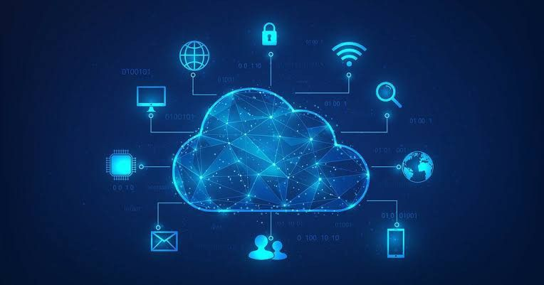
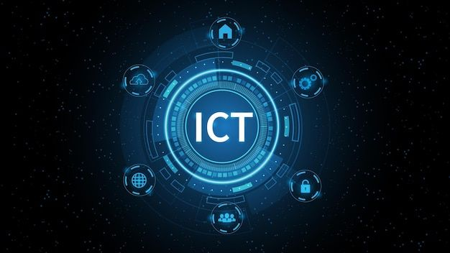
Overview of TIC
Information and Communication Technologies (TIC) are all the digital tools and systems that help people communicate, share information, and manage it efficiently.
They include computers, the internet, software, smart applications, and other digital devices. These technologies play an essential role in daily life, whether in education, work, or entertainment.
TIC facilitate the exchange of information between individuals and organizations and improve communication in various fields.
They also contribute to increasing productivity, saving time, and providing fast and accurate access to information.

Slide 5
Overview of TIC
By using TIC, students and teachers can communicate more effectively, employees can exchange data easily, and organizations can manage their operations more efficiently.
As a result, Information and Communication Technologies have become essential for societies aiming for development and progress in the digital age.
To make TIC effective in real-life applications, several technological tools and platforms are used. These tools support communication, collaboration, data management, and digital content creation.
Among the most widely used TIC tools today are Google services, Microsoft tools, version control systems such as Git and GitHub, as well as web technologies like HTML and CSS.

Slide 6

Google Services
Google Services are a set of digital tools and platforms provided by Google. They are considered an important part of Information and Communication Technologies (TIC) because they help users communicate, share information, store data, and collaborate efficiently through the internet. Google services play a major role in everyday life, especially in education, professional work, and information management. These services can be accessed easily from different devices connected to the internet.

Slide 7
Examples of Google
Services
Google Search
Google Search is a search engine that allows users to
quickly find information from all over the world,
making research and information access faster and easier.
Gmail
Gmail is an electronic mail service used for communication and the exchange of messages and files between individuals and organizations.
Google Drive
Google Drive is a cloud storage service that enables users to store, share, and access files online from anywhere and at any time.
Google Docs, Sheets, and Slides
These tools allow users to create and edit documents, spreadsheets, and presentations collaboratively, where multiple users can work on the same file simultaneously.
Google Meet
Google Meet is a video conferencing service used for online meetings, distance learning, and remote work.

Slide 8
Google Services
Google Search
Gmail
Google Drive
Google Meet
Google Doc
Online search engine
Email service
Cloud storage platform
Video conferencing service
Online text editor
Information access
Communication
Data storage and sharing
Online meetings and learning
Collaborative work

Slide 9

Relation between Google Services and TIC
Google Services support TIC by facilitating communication, information sharing, collaboration, and data management. They improve productivity and allow users to work more efficiently in a digital environment.
Conclusion
In conclusion, Google Services are widely used TIC tools that contribute significantly to education, professional activities, and daily communication by providing fast, reliable, and accessible digital solutions.

Slide 10

Microsoft Tools
Microsoft Tools Microsoft Tools are a collection of software applications developed by Microsoft. They are an essential part of Information and Communication Technologies (TIC) because they help users create, process, manage, and share information efficiently. These tools are widely used in education, business, and organizations, as they support professional communication, data management, and digital content creation. Microsoft tools are known for their reliability and ease of use.

Slide 11
Examples of Microsoft Tools
Outlook
Word
Excel
PowerPoint
Email and calendar management tool for communication and organization
Microsoft Word is a word processing tool used to create and format documents. In TIC, it helps in information creation, sharing, and communication.
Microsoft Excel is a spreadsheet application used to organize, calculate, and analyze data. In TIC, it supports data management, analysis, and information processing.
Microsoft PowerPoint is a presentation tool used to create visual slides with text, images, and charts. In TIC, it supports communication and clear information presentation.
Teams
Online collaboration tool for meetings, chat, and file sharing

Slide 12

Relation between Microsoft Tools and TIC
Microsoft tools contribute to TIC by enabling effective communication, information processing, collaboration, and data organization. They help individuals and organizations improve productivity and work more efficiently.
Conclusion
In conclusion, Microsoft Tools are widely used TIC solutions that play an important role in education, business, and digital communication by providing professional and integrated software services.

Slide 13
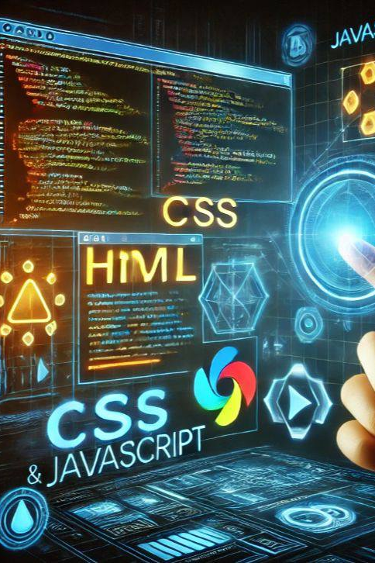
Web Technologies: HTML and CSS
The Web is one of the most important components of Information and Communication Technologies (TIC). It allows users to access, share, and publish information globally through the internet. Websites and web applications have become essential tools for communication, education, business, and digital services. To create and display content on the web, specific technologies are used, among which HTML and CSS are fundamental.

Slide 14
HTML (HyperText Markup Language)
CSS (Cascading Style Sheets)
HTML is the standard markup language used to create the structure of web pages. It defines website content such as text, images, links, tables, and forms, and organizes information using elements and tags. HTML allows browsers to correctly display content. In the context of TIC, HTML plays an important role in information presentation and organization on the web, enabling the creation and sharing of digital content worldwide.
CSS is a style sheet language used to control the appearance and design of web pages. It is responsible for the visual presentation of content, including colors, fonts, layouts, spacing, and responsiveness. CSS improves the user experience by making websites more attractive and readable. It also allows developers to separate content from design, which makes websites easier to maintain and update. As a TIC technology, CSS supports effective communication by enhancing the visual clarity and accessibility of information on the web.

Slide 15

Relation between Web, HTML, and CSS in TIC
The web relies on HTML to structure information and on CSS to design and present it visually. Together, they form the foundation of modern websites and web applications. These technologies support TIC by enabling digital communication, information sharing, and online services.
Conclusion
In conclusion, the web, HTML, and CSS are essential technologies within TIC. They allow the creation of structured, well-designed, and accessible digital content, contributing significantly to communication and information exchange in the digital age.

Slide 16

LaTeX
document preparation system widely used in academia,
research, and technical fields. It is considered a part of
Information and Communication Technologies (TIC) because
it helps in creating, organizing, and sharing structured digital information in a professional way.
LaTeX is mainly used for writing scientific documents such as reports, articles, theses, and books. It allows users to focus on the content while the system automatically manages the layout, formatting, and structure of the document.
One of the main advantages of LaTeX is its ability to handle complex documents that include mathematical formulas, tables, figures, references, and bibliographies. This makes it especially useful in fields such as computer science, mathematics, engineering, and physics.
In the context of TIC, LaTeX contributes to information management and communication by enabling the production of high-quality and well-structured documents. It also supports collaboration, as documents can be easily shared and edited using version control systems.

Slide 17

Relation between LaTeX and TIC
LaTeX supports TIC by improving the clarity, accuracy, and presentation of information. It helps researchers, students, and professionals communicate complex ideas effectively through well-formatted digital documents.
Conclusion
In conclusion, LaTeX is an important TIC tool for academic and technical communication. Its precision, reliability, and professional output make it a valuable technology for information creation and sharing in the digital age.

Slide 18

Git & GitHub
Git and GitHub widely used tools in software development and are an important part of Information and Communication Technologies (TIC). They are mainly used for version control, collaboration, and code management.

Slide 19
Git
GitHub
a version control system that allows developers to track changes made to files and source code over time. It helps users manage different versions of a project, recover previous work, and work efficiently on large projects. Git also enables collaboration by allowing multiple people to work on the same project without conflicts. Each user can make changes independently, and Git manages these changes in an organized way.
is a web-based platform that uses Git to host and manage projects online. It provides a centralized place where developers can store their repositories, share code, and collaborate with others. GitHub supports communication and teamwork by offering features such as repositories, branches, pull requests, and issue tracking. These features allow teams to review changes, discuss improvements, and manage project tasks effectively

Slide 20
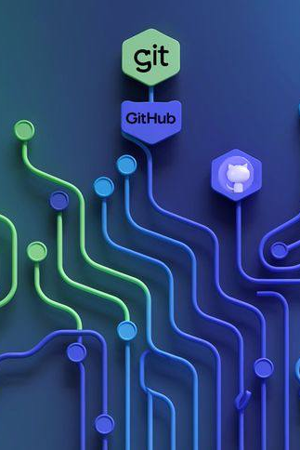
Table: Git and GitHub Comparison
Tool | Description | Main Use
Git | Distributed version control system | Track changes in source code
GitHub | Online platform that hosts Git repositories | Collaboration and code sharing

Slide 21

Relation between Git, GitHub, and TIC
Git and GitHub contribute to TIC by facilitating collaboration, information sharing, and digital project management. They improve communication between developers and help organizations build and maintain software efficiently.
Conclusion
In conclusion, Git and GitHub are essential TIC tools in modern software development. They support teamwork, version control, and efficient information management, making them fundamental technologies in the digital age.

Slide 22

Conclusion
Information and Communication Technologies (TIC)
have become essential in modern life, as they improve communication, facilitate access to information,
and support collaboration. This report presented an overview of TIC and discussed important tools such as Google services and Microsoft tools, which play a key role in communication, productivity, and information management in education and professional fields. It also highlighted the importance of Git and GitHub in software development and teamwork. In addition, web technologies like HTML and CSS were presented as fundamental tools for creating and sharing digital content, along with LaTeX for producing high-quality academic documents. Overall, mastering TIC tools is crucial for students and professionals to enhance skills, productivity, and adaptability in the digital world.

Slide 23
Thank You

